Slide 1
Python tutorial
Reinforcement Learning 2020, Professor Chiu, NTHU

Slide 2
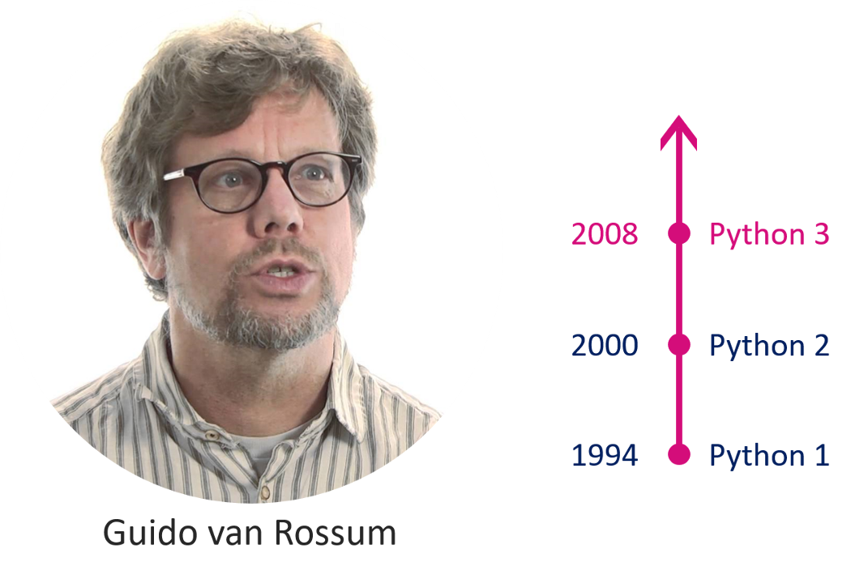

What is Python?
Python is an easy to learn, powerful programming language. It has efficient high-level data structures and a simple but effective approach to object-oriented programming.

Slide 3
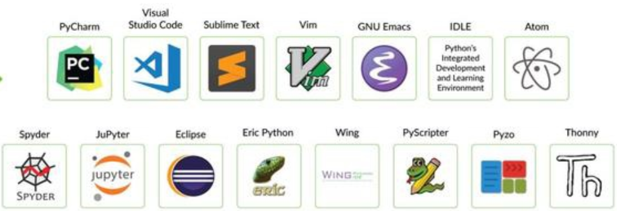
Python IDE
Using Python IDE can help you debug and type the code easily.
There are lots of IDE for python that you can use. (ex. PyCharm, Spyder, VS, JuPyter, …)
For example next ppt will help you install Spyder, but you can choose any IDE you like as your tool.

Slide 4
Download Anaconda (Spyder)
Download page :
https://www.anaconda.com/products/individual
Other pages for more info about installing anaconda :
https://academy.vertabelo.com/blog/how-to-install-python-spyder-ide/
https://codingonmac.blogspot.com/2017/08/windows-10-64bitsspyder-anaconda.html

Slide 5
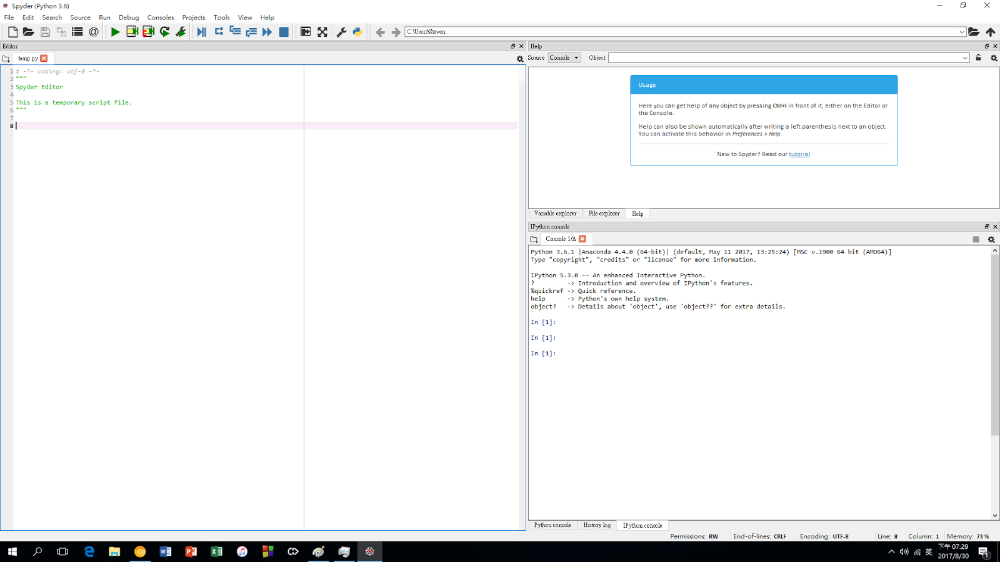
Open your Spyder and start coding!

